Slide 1


Bonjour!
St. Anthony C.F.I.S.
Québec City
WED. FEB.20 – SAT. FEB. 23,
2019
www.perspectives-edu.com
Notes:
Introduce the company and note we are celebrating 30 years. Discuss departure time for the school – students should arrive at least 30 minutes in advance and be prepared with all of their belongings including wallets, health cards!
TICO regulations

Slide 2


Perspectives, the only one of its kind
A family-owned business, 100% Canadian
Quality service in student travel for since 1988
Winner of two educational travel awards
Experienced Ontario educators , familiar with the expectations and requirements of the Ontario curriculum
Provides affordable and memorable educational experiences, in English and in French
www.perspectives-edu.com

Slide 3
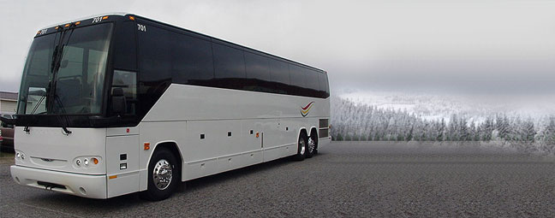
Depart: Québec
Wed. Feb.20- Sat. Feb. 23, 2019
6h45 a.m. load bus and depart from school
1 suitcase
1 carry-on (knapsack)
Snacks, Water
DVD player, washroom
Highway Coach is safe, reliable and comfortable
Rest stops en route, including a stop for lunch
(or lunch from home)
Bon Voyage !

Slide 4
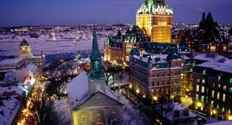
Meet your bilingual Perspectives guides at La Vieille Maison du Spaghetti in Quebec City

Slide 5

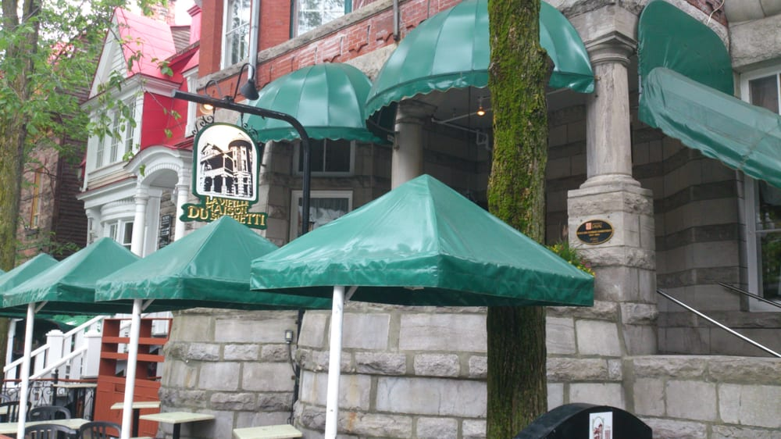
La Vieille Maison du Spaghetti
        Italian Dinner (included)
Appetizer: Caesar Salad
Choice of :
Roast Chicken with fries and
vegetables OR
Lasagna au gratin
Fresh bread and butter
Dessert
Beverage
Gluten-free options/ special meals due to allergies available with advance warning
Bon Appétit!

Slide 6

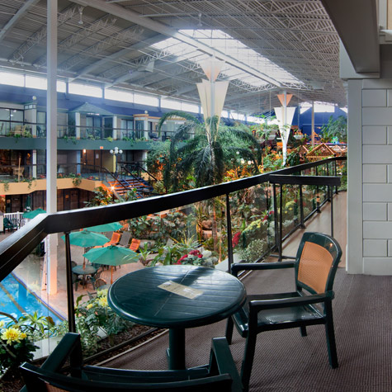
Hôtel Québec
www.hotelsjaro.com

Slide 7
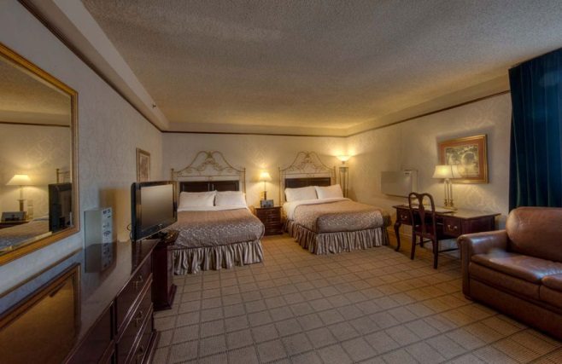

Lodging
4 students per suite
Rooming list organized at the school the month before departure
Telephone
Television
Dedicated Night
Security for St. Anthony

Slide 8
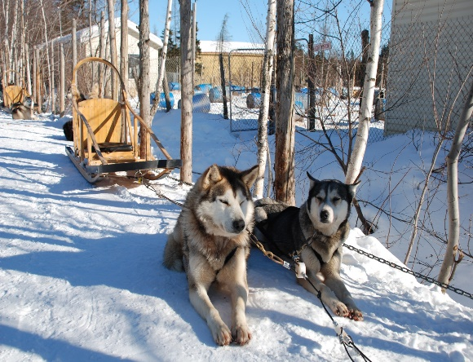
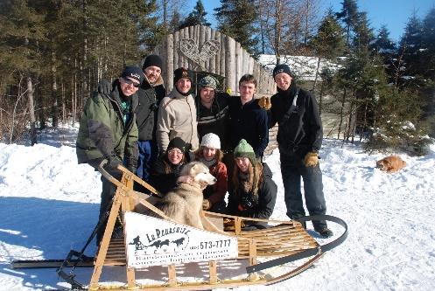
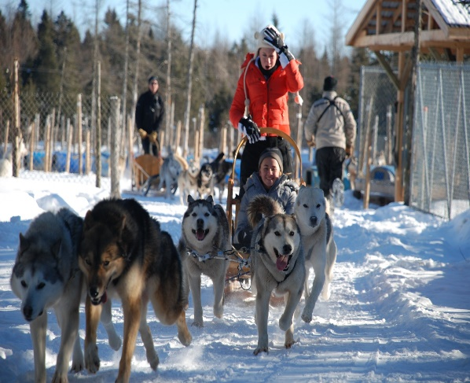
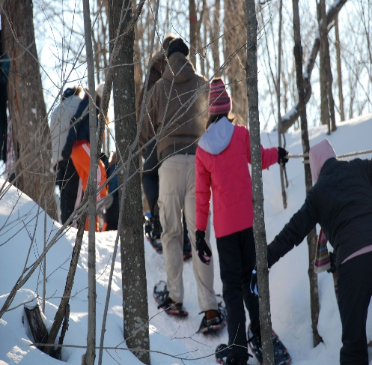

La Poursuite
American Buffet Breakfast served at hotel (included)
Morning activities at La Poursuite:
  Dogsledding with a trained driver on beautiful trails
  Snowshoeing with experienced guides
  Tube Sliding

Slide 9

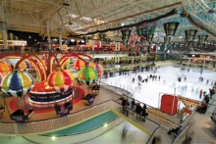
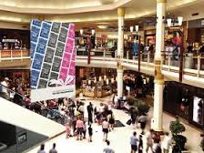
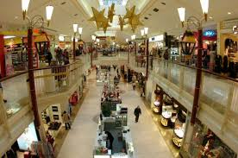
Les Galeries de la Capitale:
Lunch (at student’s expense)
280 shops , 35 restaurants
Amusement park
Depart for Beaupré Coast

Slide 10
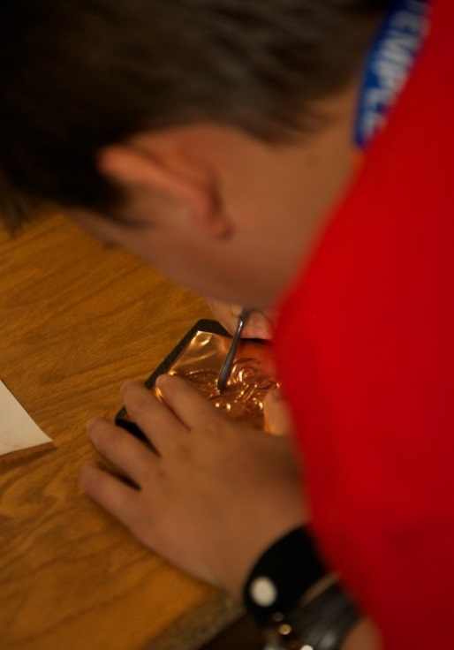
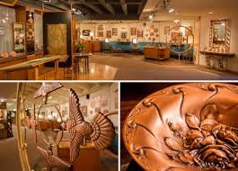
Musée du Cuivre
Albert Gilles
Visit of the Copper Museum
85 years of unique experience in the art of copper embossing
Workshop where students create their own work of art on copper to take home with them

Slide 11
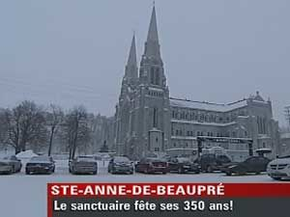
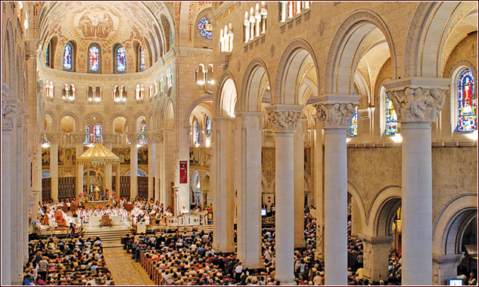
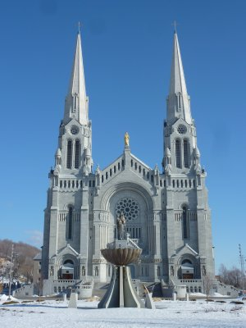
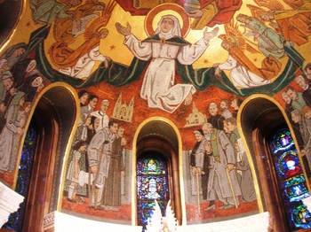
Sainte-Anne-de-Beaupré
Sainte-Anne-De-Beaupré Basilica: French Mass
Ste Anne, patron saint of Québec
1658: first chapel built , first miracle
Rebuilt 3 times
First Basilica built in 1876, destoyed by fire in 1922
Present Basilica rebuilt in 1926
Visited by millions of pilgrims every year
240 stained glass windows, style is Neo-gothic, Neo-Romanesque

Slide 12
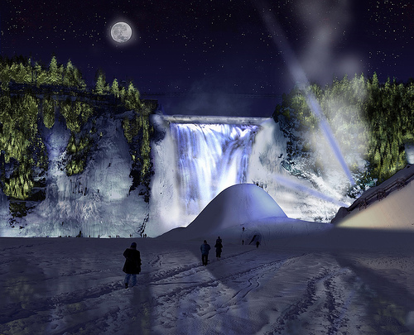
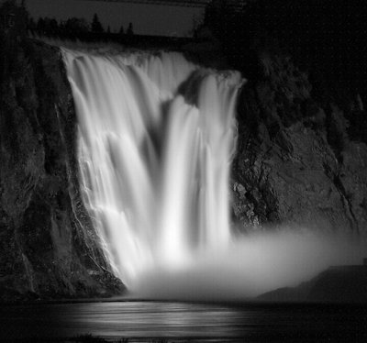
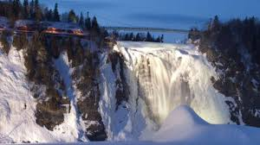
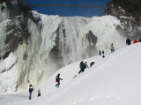
Montmorency Falls
Montmorency Falls: 84 meters (275 ft) high, (30 m (98 ft) higher than Niagara Falls!)

Slide 13


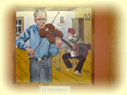
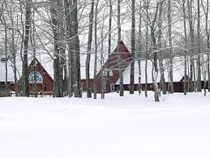
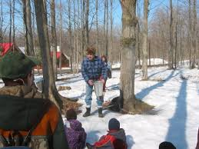
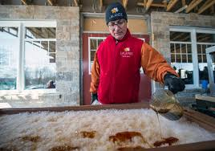
L’En-Tailleur
Visit of a Sugar Cabin on l’Île d’Orléans (8 generations)
Traditional québécois dinner (included)
See how maple syrup is made
Folkloric music & dancing, fiddles & spoons
Maple taffy

Slide 14
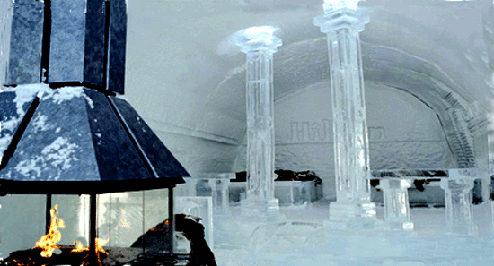
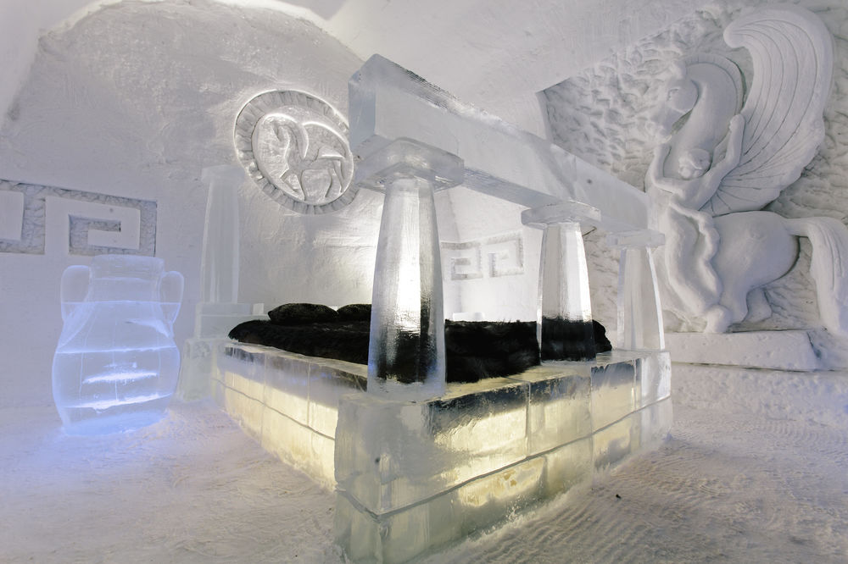
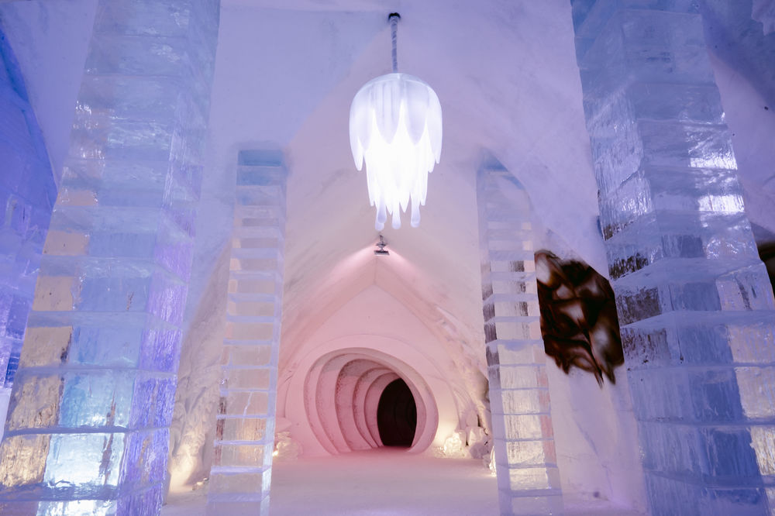
l’Hôtel de Glace
American Buffet breakfast (included) served at hotel
Guided visit of the famous Ice Hotel
Ice chapel, exhibit rooms, art gallery etc.
Rebuilt every winter

Slide 15

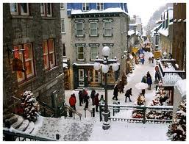
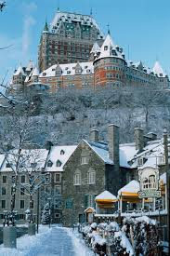
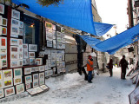
Vieux Québec
Guided Walking Tour
Guided Walking Tour with local guides
Château Frontenac
Rue du Trésor
Rue St Jean
Terrasse Dufferin
Place Royale , le Petit Champlain

Slide 16
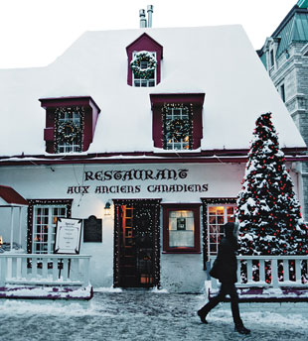

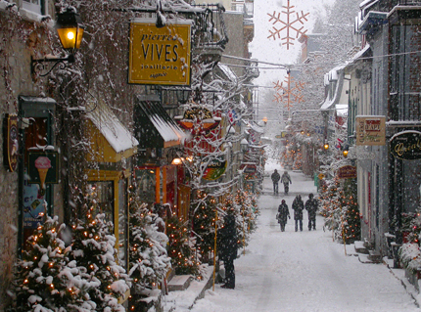
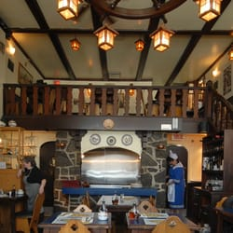


Lunch in Old Québec
( at student’s expense)
-

Slide 17
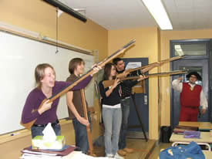
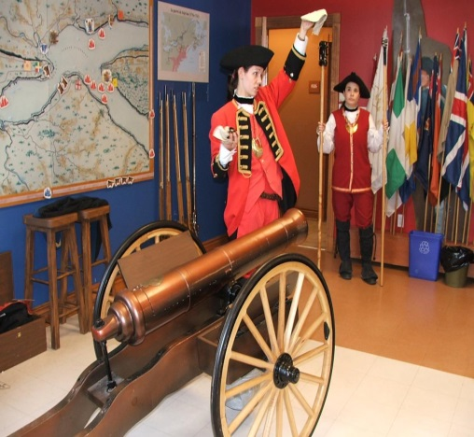


Soldier of Martello Tower Workshop
Workshop about the Siege of Québec in 1759:
Interactive historical activity, competitions, games, surgical demonstration of the period, historical quiz
Accessories : rifles, artefacts, uniforms, multimedia

Slide 18
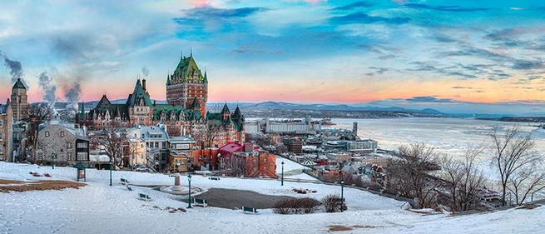
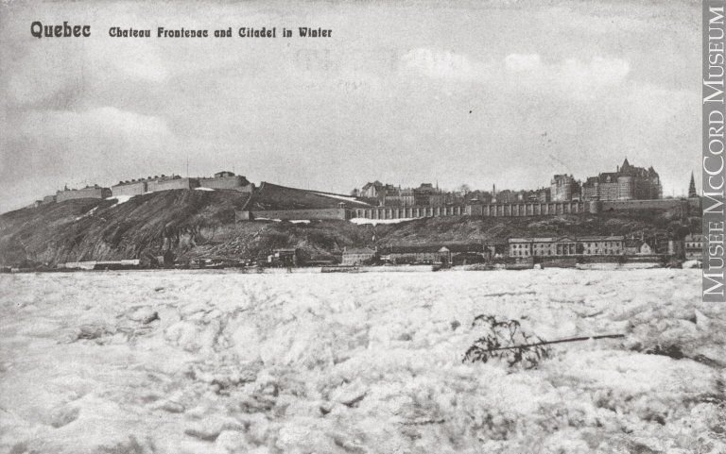
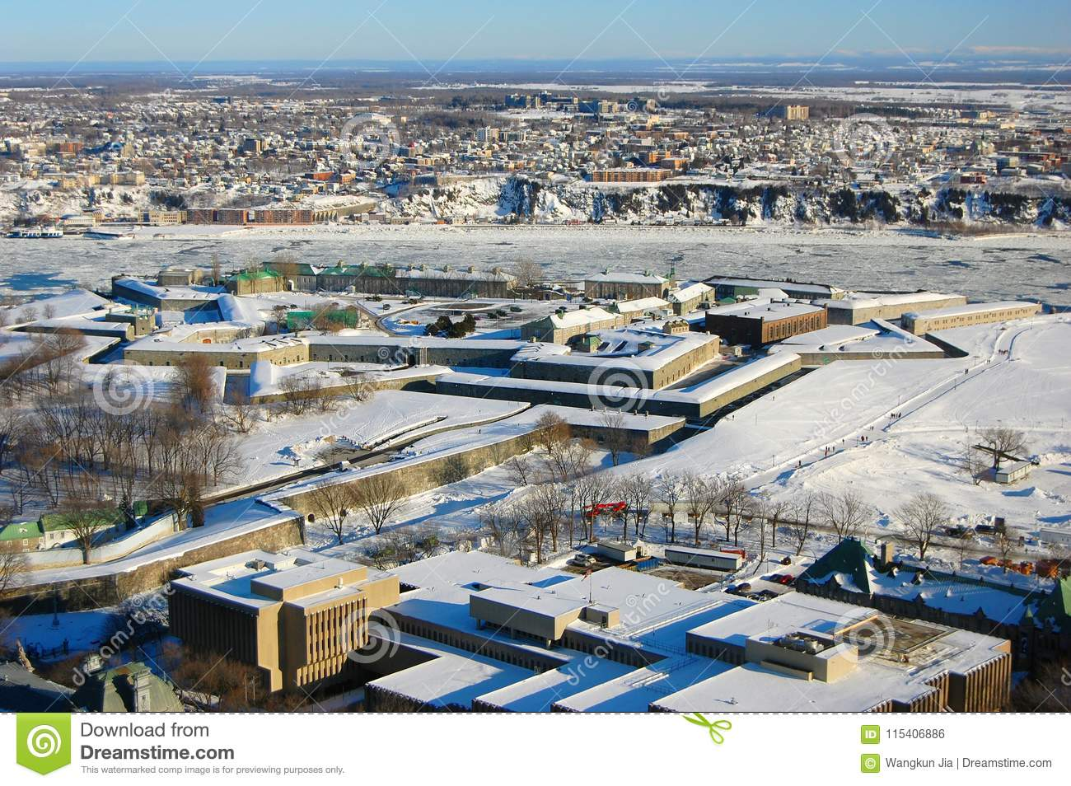
Plains of Abraham

Slide 19
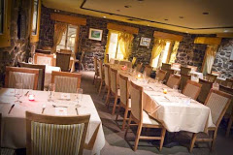
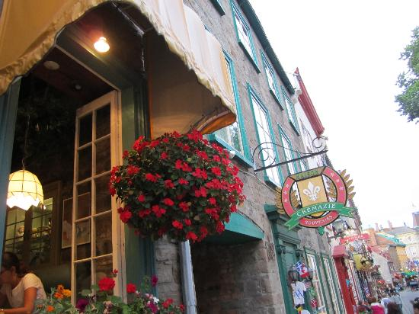
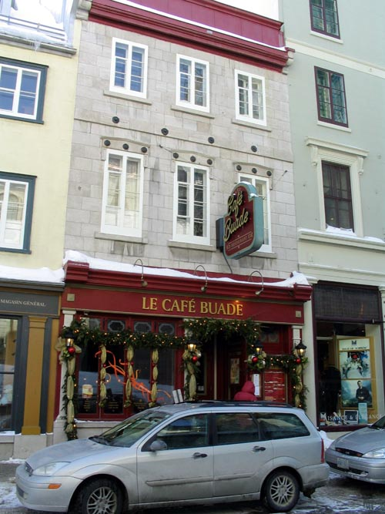
Café Buade
Supper (included) at Café Buade
Situated close to the Château Frontenac
Original stone walls
Named after the Governor Général Louis de Buade- 17th century

Slide 20
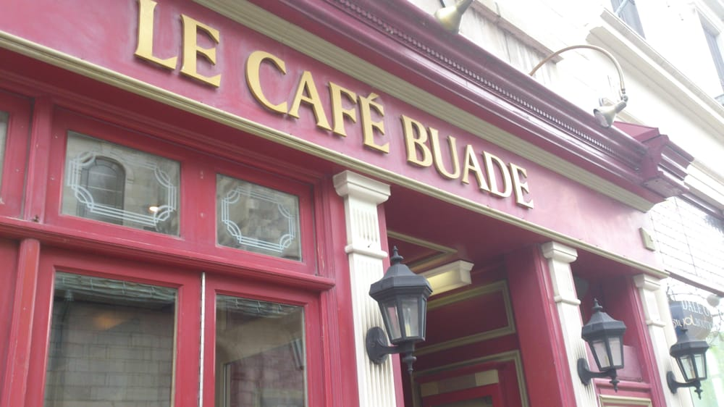
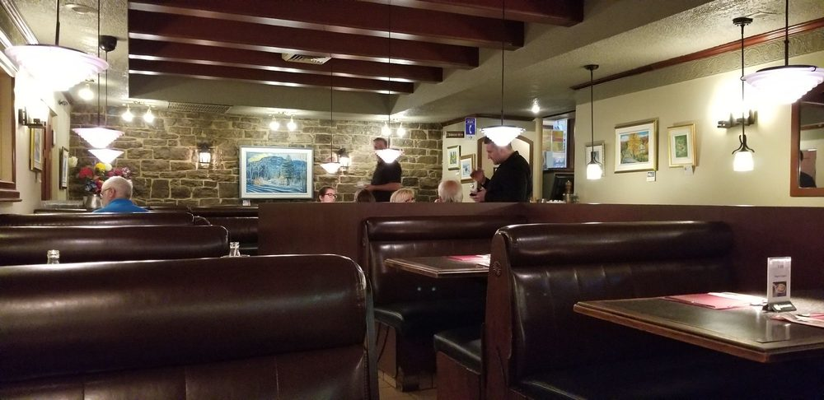

Café Buade Menu
Soup of the day
Entrée Choices:
Salmon fillet in dill cream sauce, rice and vegetables
B.B.Q chicken leg, served with bread bun,
french fries and B.BQ sauce
Beef stir fry in teriyaki sauce, served with rice
Dessert and beverage
Vegetarian choice is available upon request
This Photo by Unknown Author is licensed under CC BY-SA-NC

Slide 21

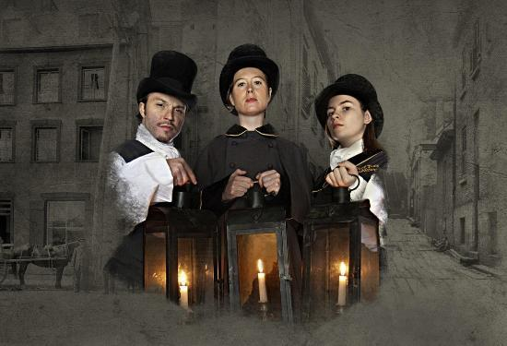
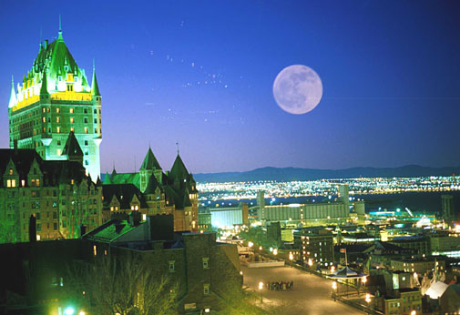
Ghost Tour of Old Québec
Guided tour by lantern light
350 years of mysterious ghost sightings, tragedies and hauntings.

Slide 22
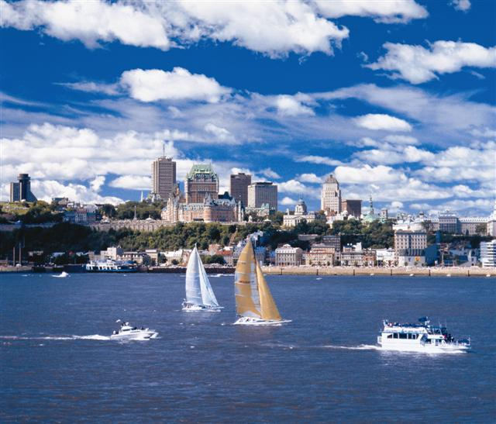
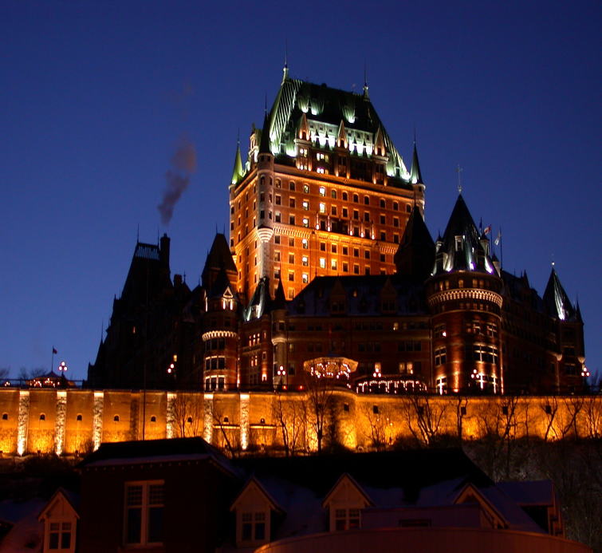
Au Revoir Québec !
Saturday Feb. 23: Preparation & loading of luggage
American Buffet Breakfast (included) served at hotel
Depart for London,with stops en route for lunch and dinner
(at student’s expense)
Arrival back at school at approximately 9:00 p.m.

Slide 23
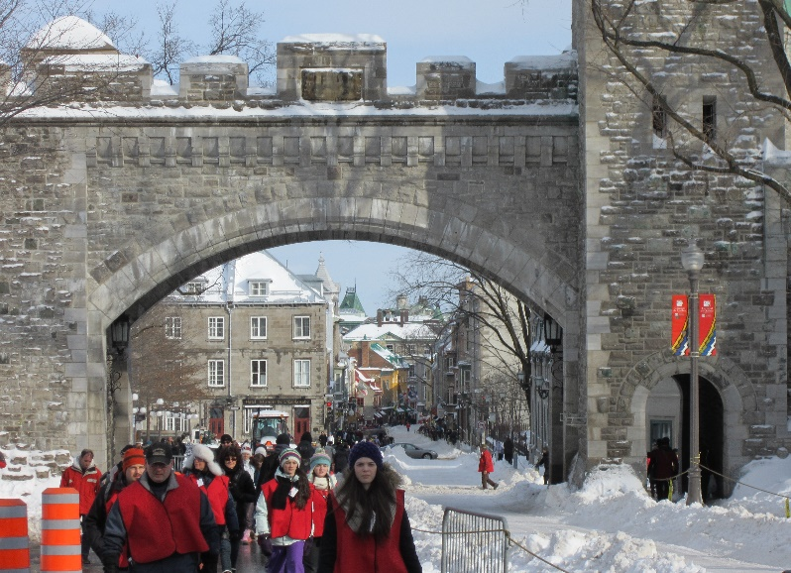
What to Bring
Be prepared for outdoor activities:
  Ski jacket
  Ski pants or waterproof jogging pants
  Winter Boots & thermal socks A MUST
  Waterproof mittens ~ 2 pairs
  Thermal underwear, leggings, comfortable pants
  Hat or tuque and a neckwarmer
  Sweaters & Turtlenecks
  Casual clothing
  Shoes for hotel
Notes:
Check weather closer to the date weather network St Donat webcam – kids need to assist in packing their own bag. Boots are SO important for the comfort and enjoyment of your experience – must be “winter” boots and not fashion boots like UGGS or others. Suggestions for younger students: When child does their own packing they know what they have to pack for return. Divide $$ into ziplock bags for daily lunch purchases. There are no laundry facilities at the site – pack extra items for comfort Students must be able to lift their own suitcase. Label ski equipent and other valuables with their name and full name of school – no abbreviations – use white hockey tape and a sharpie

Slide 24
Included Features:
Transportation by 2 highway coaches with DVD, toilet, PA system and transponders for hwy 407
3 nights accommodation at Hotel Québec
Night Security(2) dedicated only to Saint-Anthony
Meals: 3 Breakfasts, 3 Dinners
Guided Tours, all Entry fees & Service charges
2 Bilingual Perspectives Tour Guides
Perspectives Price:
$740.00 (Includes taxes, based on 95-99 students)
$759.00 (Includes taxes, based on 90-94students)

Slide 25


Not Included Features
Lunches - Budget $10-$15 per day
1 Dinner return trip - Service Centre stop
Optional: Trip Insurance World Youth All Inclusive Policy
  $50.00 due with deposit
  Covers Pre-trip Cancellation, Trip Interruption and Out of Province Medical
  Tax Included
  Due with registration on-line, paid by credit card (MC/VISA)
Notes:
Explain the Trip Cancellation inclusions/exclusions and importance for insurance. No insurance no refunds.

Slide 26

World Travel Insurance Youth Policy = Peace of Mind!
Pre-trip Cancellation - Trip Interruption - Out of Province Medical
Examples of reasons for cancelling for reimbursement:
  new medical situation
  family bereavement
  government actions
Check other coverage such as a credit card or group benefits
  Ensure student coverage when not travelling with the benefit/card holder.
Claims are made directly to the insurance company
Payment is due on registration for the trip
Payable online with a credit card
Please reference FAQ section of Perspectives Website for a link to full policy details www.perspectives-edu.com
Notes:
By law as a TICO licensed Tour Operator in the Province of Ontario we are obligated to offer our clients (your children) the option to purchase trip cancellation insurance. This insurance is specific to travel and is not the school insurance you are offered at the beginning of each school year. Manulife Financial is our insurance carrier offering a World Youth All Inclusive Plan and includes Pre-trip Cancellation, Trip Interruption protection and Out of Province Medical coverage. Reasons for cancelling where a full refund including the initial deposit are covered include – an unexpected illness (like the flu) or a non-pre-existing medical situation. With a Doctor’s note you are reimbursed. Family bereavements are also covered, and government actions (like a subpoena to court or a strike). Same applies for Trip Interruption coverage – the unused portion of the trip is reimbursed. Out of Province Medical coverage – while OHIP is recognized in all provinces of Canada extra charges may occur. You need to pay first at the clinic/hospital in QC and be reimbursed by OHIP or by making a claim through the Insurance company. Price of the insurance is due with deposit on registration and is payable online. Your child’s date of birth is required to process this request for purchase. Check your own personal insurance like group insurance from your place of employment to determine if you already have this coverage. You may have a credit card with Trip Insurance Coverage, however ensure that your child is covered when travelling independent of you. Insurance is optional, but it offers peace of mind for your investment of travel. More information can be found on Perspectives website and on your trip organizers online account.
Please note: The trip insurance does not cover “changing your mind”, a sporting event, dance competition, or behaviour issues.

Slide 27

Register early for more chances to win!
Notes:
Students will automatically be entered in to a computer generated draw to win a credit of $100. Register and pay a deposit now for more chances to win. Information is available online once you register.
Schools will automatically be entered in to the draw on confirmation of their trip to win a $300 credit to be applied to the trip.

Slide 28

Registration form is the “ticket”
Register online with instructions and trip code distributed by teacher
Go to www.perspectives-edu.com
Create a Participant User ID and password & Log in to Website
Complete Registration Form
Pay Insurance (optional) by VISA or MC
Online Registration and Payment is a Breeze!
It’s as easy as 1 -2 -3!
Notes:
Draw attention to parents – this form MUST be completed and submitted in full with a signature! Attached to the paper copy brochure, is available via email, and NEW payment online feature! Explain and emphasize all options

Slide 29



On-line Registration www.perspectives-edu.com
Notes:
Go to our website
Log in through the Owl
Select Log In from the Website Banner
Click on START HERE below Create a Student/Chaperone/Participant Account

Slide 30

Registration …. Easy as 1-2-3!
Create your participant registration account and include your Trip Code! (Use the email of a parent)
Notes:
Tell us about you
School Name , Grade & Trip Code – Reminder – If they enter Trip code in Profile set up they will be taken directly to the registration on first log in.
Reminder that the email address used here is the one all confirmations will be sent to- PLEASE ENSURE IT IS A PARENT/GUARDIAN EMAIL IF UNDER 18
Important to provide us with any Allergy or Health information so we can ensure your students comfort
Security “Capcha” or “Catchup”. Helps ensure data is secure by preventing automated programs from logging in.
Once you complete this step your User Profile can be used for any trip with Perspectives now and in the future

Slide 31

Complete the registration form
*(If you entered the trip code in account set-up, you will be taken directly to this registration form.)

Slide 32


Registration …. Easy as 1-2-3!
Register for your Trip! Log In with User ID Created in Step 1 and Complete the
registration form*
*
Notes:
Now that you have an active account log in to Perspectives ( it should default to the user name you set up in step 1) and then enter your password
If you entered the Trip code in account set up then you will be taken directly to the registration form
Asterisk shows - If you did not enter the Trip code you can simply enter the Trip code (provided by teacher) in the upper left field as indicated and click “Search”
Complete the registration form and don’t forget to click Register to Save your registration

Slide 33

Pay For Your Trip/Insurance
3. Pay for your trip !
  Payment options are selected by your school (online payments to school)
  Please follow instructions given by the organizing teacher
  Click on the Blue Highlighted area in Deposit/Payment status to pay optional insurance
  If insurance is not required, please choose “no” before exiting
Notes:
Payment method is chosen by the school. Payment is by cheque or credit card.
The Payment status area that is highlighted in blue indicates the next steps whether it is Click to Pay Deposit or Click to Pay Insurance
Parents can still pay by cheque and register on-line. *** Just follow the prompts
*** Reminder that if it is school only that insurance payments are only via credit card
Paypal is well known, trusted and secure.

Slide 34
St. Anthony Payment Method
Participant registers online with instructions (includes trip code) received from school
Pay optional insurance($50.00) online by credit card MC/Visa or indicate “no”
Pay initial deposit of $100.00 (non-refundable) online to the school
Pay further installments online to the school, according to timelines outlined by the school

Slide 35

Memories to last a lifetime

Slide 36


Questions??

